Slide 1
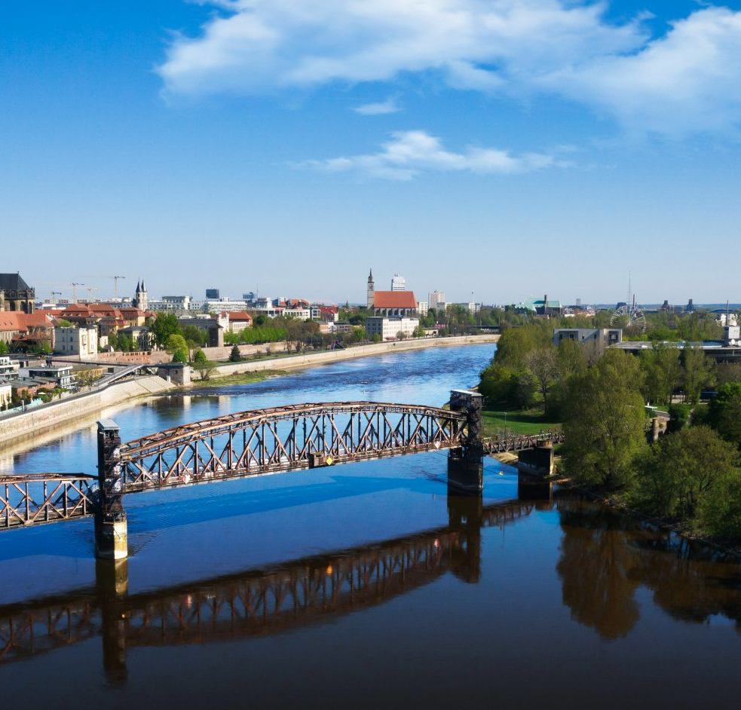
Simulation Project -
Team Tetrahedron
Simulation Project - Team D
Milestone #5- Simulation Program
Milestone #5 –
Simulation Program
Image source: https://cdn.ottopix.de/wp-content/uploads/2019/04/Magdeburg-Panorama-%C3%BCber-der-Hubbr%C3%BCcke.jpg

Slide 2
Agenda
01
02
03
04
05
Simulation Project - Team D
Milestone #5- Simulation Program
The Simulation Program
Modularization
Build a simulation model of the current node
System Design and special issues
Differences to the Conceptual Model
Verification
Difficulties faced
Compare the Simulation model with Conceptual Model
Behaviour of Agents in the system.
Brief details on the challenges faced and how we were able to resolve

Slide 3
01
The Simulation Program
Simulation Project - Team D
Milestone #5- Simulation Program
It is the imitation of real world or creating a working analogy real life using computer-based model..
Simulation can overcome deficiencies on assumptions in conventional methods.

Slide 4
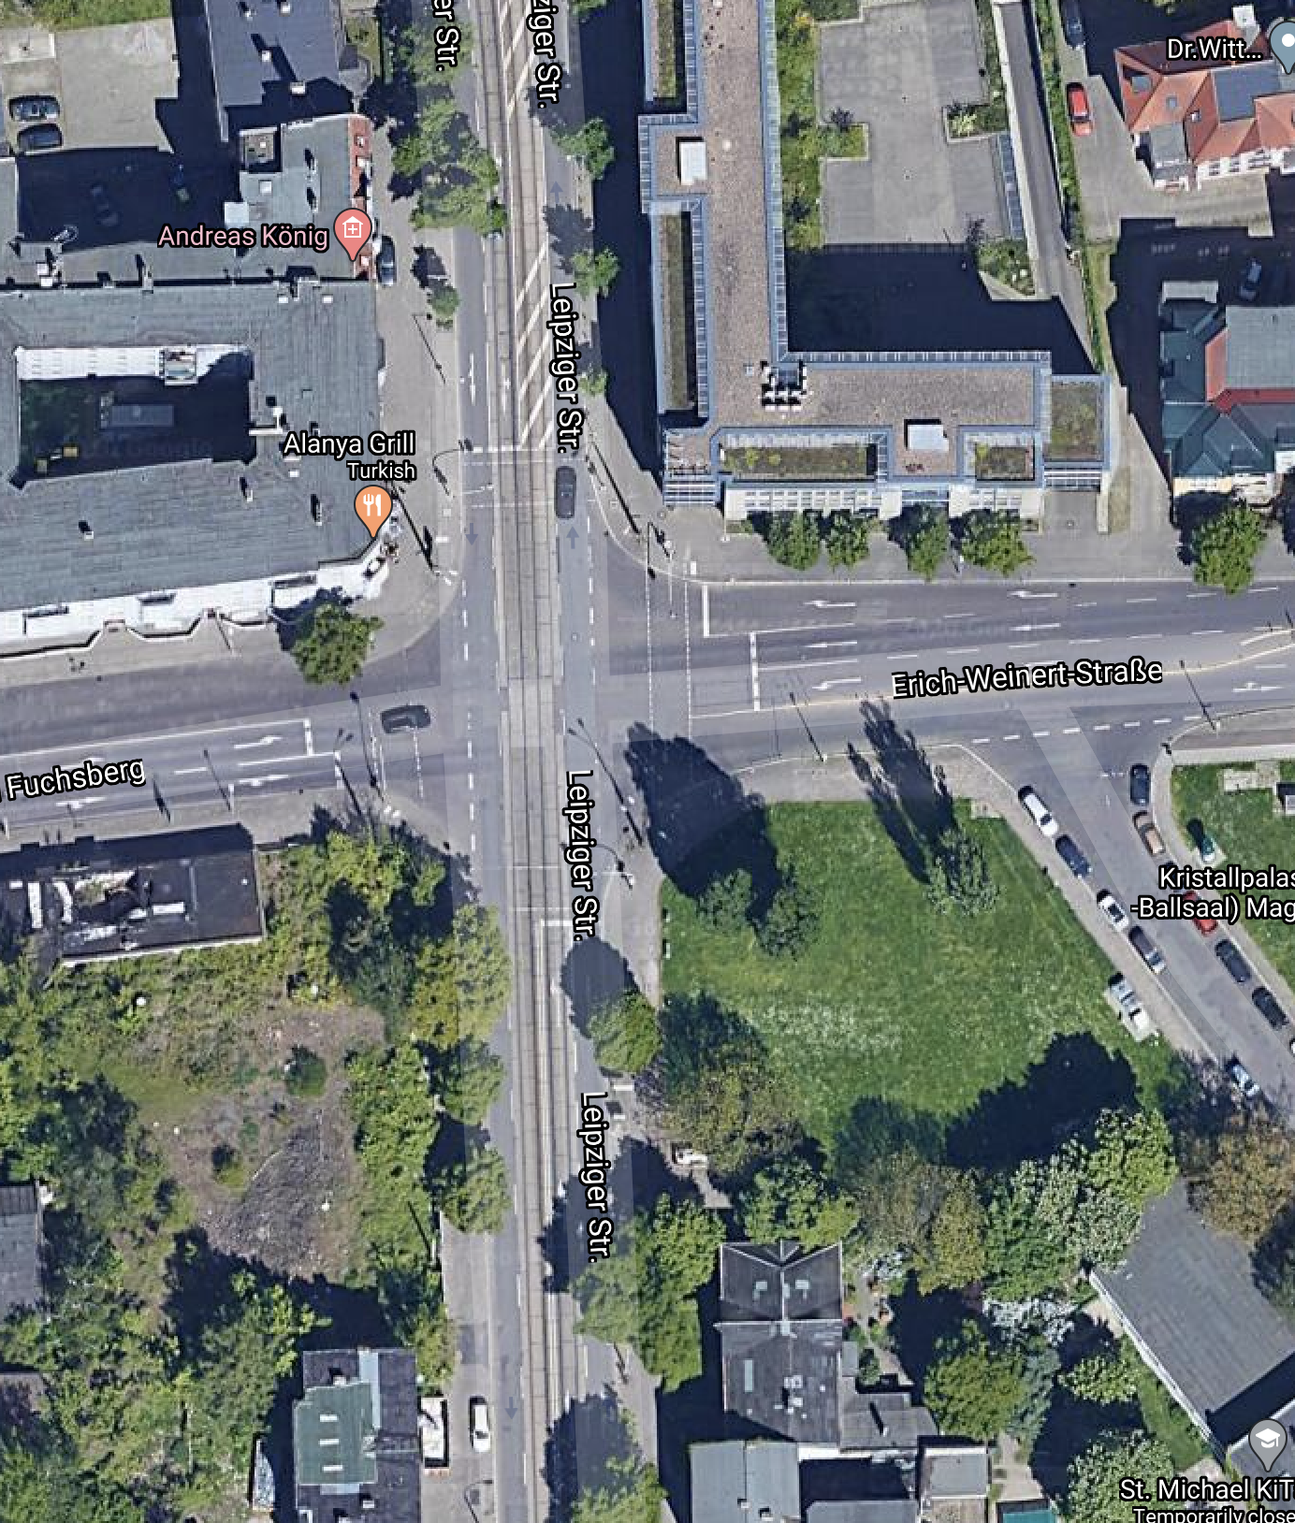
The Node
Simulation Project - Team D
Milestone #5- Simulation Program
The node consists of conjunction of 3 different roads.
01
Leipziger Straße from North and South
02
Am Fuchsberg from the West
03
Erich-Weinert Straße from the East

Slide 5
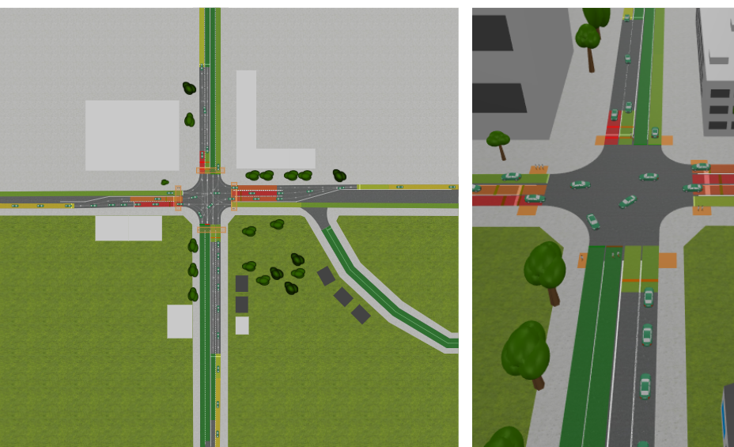
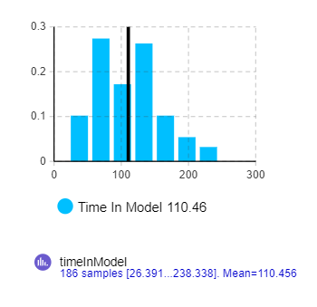
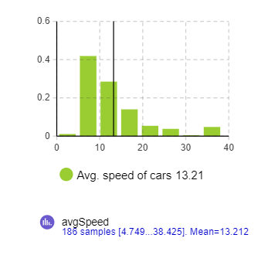
Simulation Model
Simulation Project - Team D
Milestone #5- Simulation Program

Slide 6
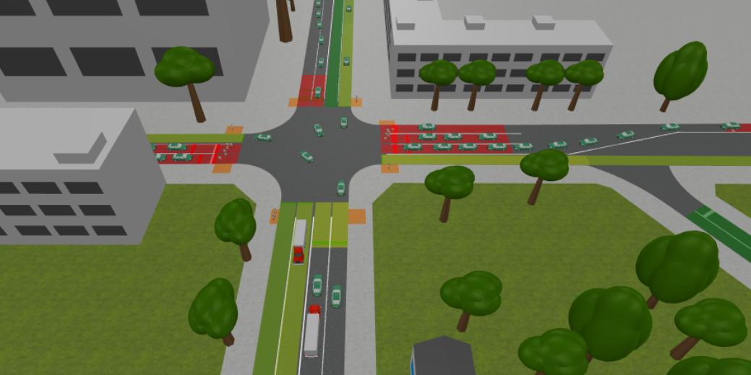
Simulation Project - Team D
Milestone #5- Simulation Program

Slide 7
Program Structure
Simulation Project - Team D
Milestone #5- Simulation Program
Road Network
Identifying and Populating Agents
Assumptions
Controlling the behaviour of Agents
Model Pedestrian Crossing
Run the model and verify

Slide 8
02
System Modularization
Simulation Project - Team D
Milestone #5- Simulation Program
System Design and special issues

Slide 9
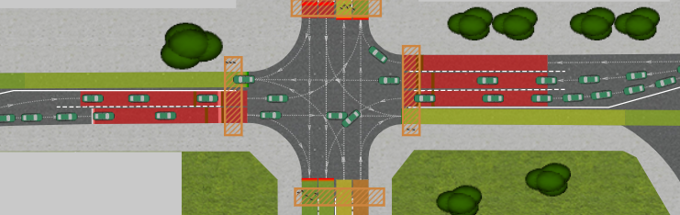
Roads and Lanes
Simulation Project - Team D
Milestone #5- Simulation Program
Am Fuchsberg - Erich-Weinert Straße(S)

Slide 10
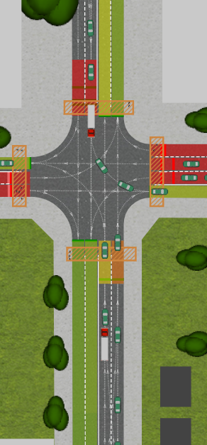
Roads and Lanes
Simulation Project - Team D
Milestone #5- Simulation Program
Leipziger Straße(N)
Leipziger Straße(S)

Slide 11
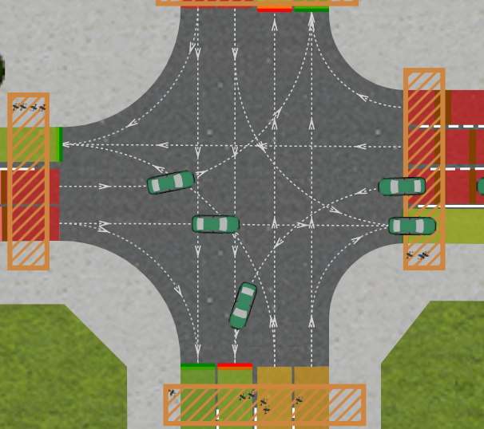
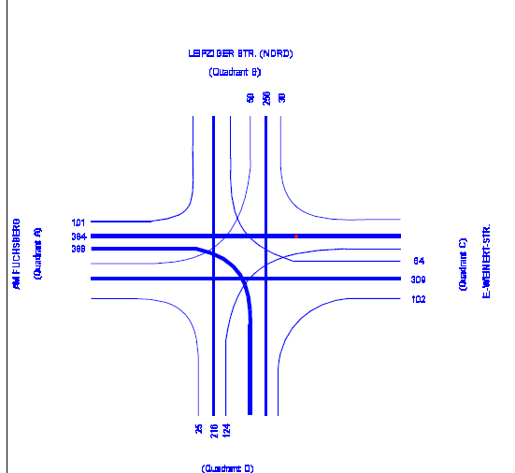
Node Intersection
Simulation Project - Team D
Milestone #5- Simulation Program

Slide 12
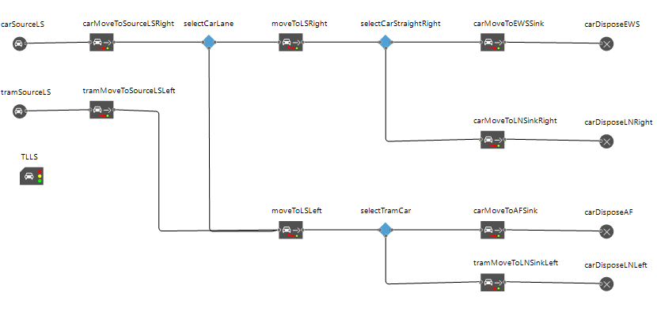
Modelling Agents on the Road
Simulation Project - Team D
Milestone #5- Simulation Program
Leipziger Straße(N)

Slide 13
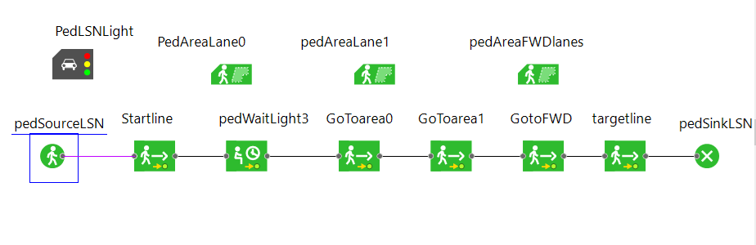
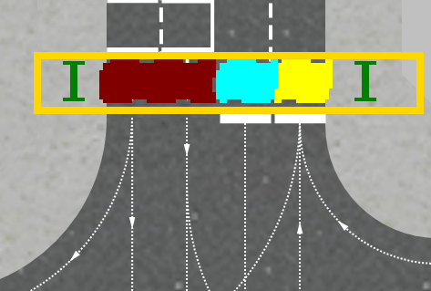
Pedestrian Crossing
Simulation Project - Team D
Milestone #5- Simulation Program
Leipziger Straße(N)

Slide 14
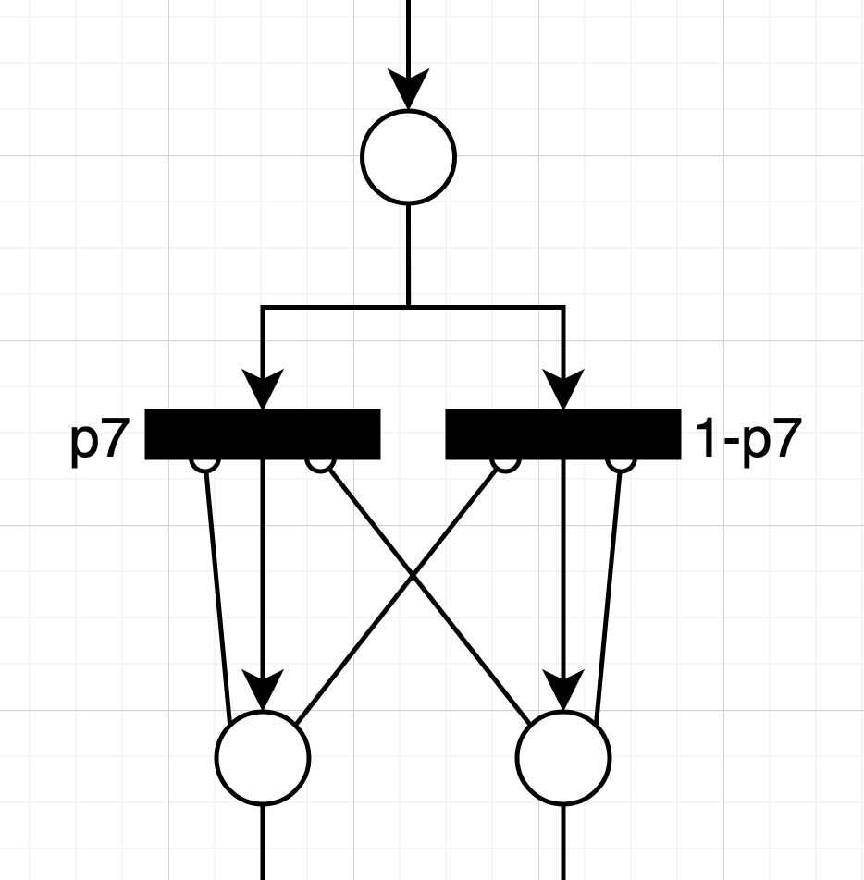
Differences to the conceptual Model
Simulation Project - Team D
Milestone #5- Simulation Program
03
Cars sharing the same lane
Timed transitions to represent car movement
Intermediary stop places for intersections
Traffic lights

Slide 15
Verification
Simulation Project - Team D
Milestone #5- Simulation Program
04
Collision detection for different inputs.
Behaviour of the agents for complete simulation run
Syntactic errors are verified
Design specifications from conceptual model are met

Slide 16
Difficulties Encountered
Simulation Project - Team D
Milestone #5- Simulation Program
05
Collision detection
Pedestrian modelling
Control Lane Changing
Traffic lights

Slide 17
✓
✓
✓
✓
✓
✓
✓
✓
Simulation Project - Team D
Milestone #5- Simulation Program
Tasks completed so far
Complete Project Plan
Data Analysis
Estimate time per work packet.
Completed Building simulation model
Update work as issues in GitHub.
Made detailed Plans on how to work on validation of model efficiently.
Completed the conceptual model.
Started working on final report

Slide 18
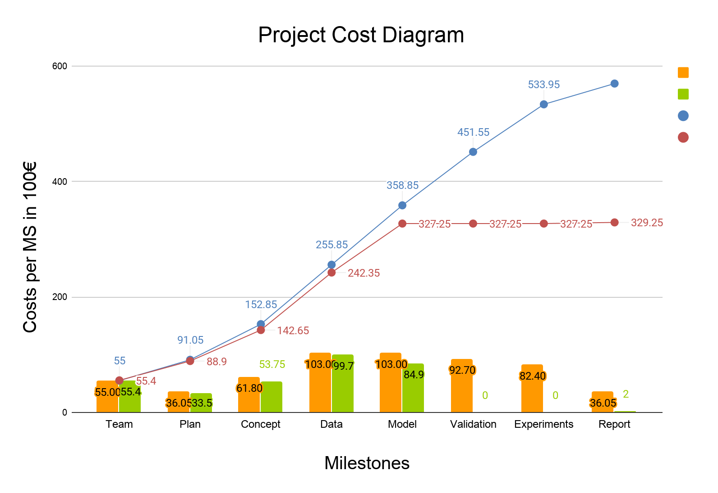
Cost comparison
Simulation Project - Team D
Milestone #5- Simulation Program
Estimated cost
Actual cost
Cumulative estimate
Cumulative actual

Slide 19
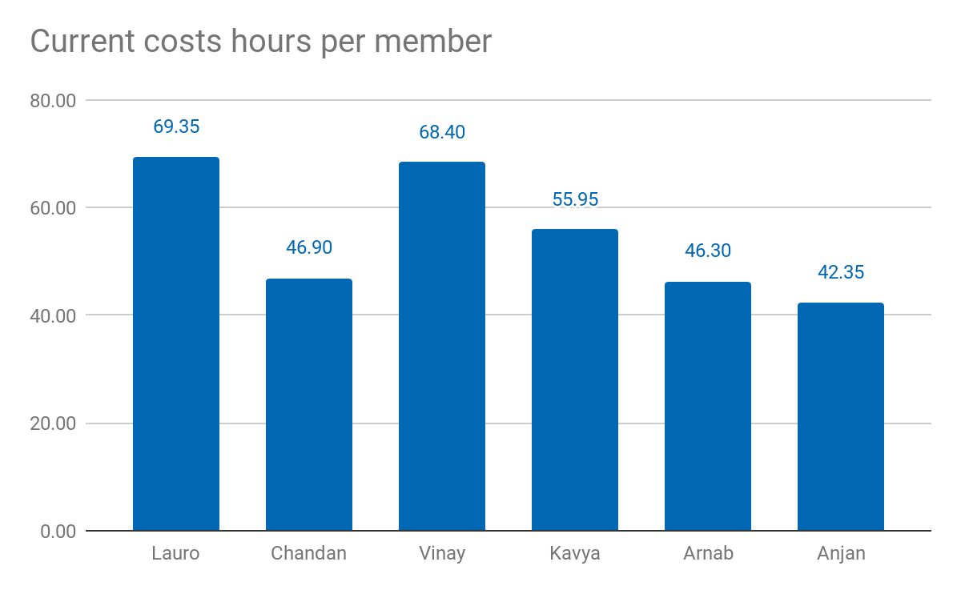
Current costs as % of total cost: 54.88%
Current costs: 32.925,00 €
Simulation Project - Team D
Milestone #5- Simulation Program

Slide 20
Lessons learned
01
02
03
04
Simulation Project - Team D
Milestone #5- Simulation Program
Too much cleaning of data may lead to missing data
Getting to know the usage software documentation before hand could save time and avoid changes later
Need to balance parallel working and version control of the model efficiently.
Learn to balance all the subject parallely to avoid last minute rush up

Slide 21
Anylogic cloud Link to the simulation model
Simulation Project - Team D
Milestone #5- Simulation Program
https://cloud.anylogic.com/model/a4bf2174-d8cc-42e4-924b-0103e3c5f223?mode=SETTINGS

Slide 22
05
Thank you!
Simulation Project - Team D
Milestone #5- Simulation Program
Questions?

